Slide 1

EXPLORING AND ASSESSING THE EXCELLENCE OF REACT JS FRAMEWORK
Using E-Commerce Application

Slide 2
TEAM GUIDE –
Dr. P.PARDHASARADHI
TEAM MEMBERS:
V.KOTESH NAG - Y20ACS586
V.NAVEEN - Y20ACS587
VISWAJIT VERMA - Y20ACS585
P.AKASH - Y20ACS530
BATCH : C5

Slide 3
ABSTRACT
React.js is a powerful JavaScript library for building user interfaces with a component-based architecture, efficient Virtual DOM, and emphasis on code reusability and performance optimization. Its flexibility makes it a popular choice in modern web development with strong community support.
The e-commerce platform caters to middle-class families with user-friendly features like product search, filtering, sorting, and cart management, ensuring a safe and convenient online shopping experience.
Here, we explain important aspects of ReactJS compared to other frameworks and how they help in creating applications.

Slide 4
EXISTING SYSTEM
Aspect | React | jQuery | Angular | ASP.NET MVC | JSP (JavaServer Pages)
Language | JavaScript, JSX | JavaScript | TypeScript, HTML | C# | Java
Rendering | Client-side rendering | Client-side rendering | Client-side rendering | Server-side rendering | Server-side rendering
Syntax | JSX (JavaScript XML) | HTML, JavaScript | Angular-specific template syntax | C#, Razor syntax | Java, JSP syntax
State Management | React Hooks, Context API | Direct manipulation of DOM | RxJS, NgRx, built-in services | Models, Controllers, Entity Framework | JavaBeans, JSTL
Project Setup | Create React App | Download jQuery library | Angular CLI | Integrated with Visual Studio IDE | Integrated with Java IDEs
Command to Run | npm start | Include jQuery library in HTML | ng serve | Deployed on ASP.NET servers | Deployed on Java servers
Component Structure | Component-based architecture | Direct manipulation of DOM | Component-based architecture | Component-based architecture | Component-based architecture
Community | Large and active community | Widely used and extensive community | Large and active community | Strong community, integrated with .NET | Strong community, integrated with Java
Flexibility | More flexible, choice of state | Highly flexible, can be used anywhere | Highly flexible, extensive ecosystem | Less flexible, integrated with .NET | Highly flexible, integrated with Java

Slide 5
PROPOSED SYSTEM
Framework/Library | Language | Drawback | How React Overcomes it
AngularJS | TypeScript | Complex data binding and two-way data binding | React utilizes a unidirectional data flow, simplifying data management and avoiding data binding issues.
jQuery | JavaScript | Poor performance with large-scale applications | React's virtual DOM and efficient rendering make it suitable for building large-scale applications with better performance.
ASP.NET MVC | C# | Limited flexibility in UI development | React's component-based approach and reusable components offer greater flexibility and scalability in UI development.
JSP | Java | Mixing Java and HTML can lead to complex code | React separates concerns with JSX, keeping the UI logic separate from the business logic, leading to cleaner and more maintainable code.

Slide 6
DESIGN METHODOLOGY
Excellence | React.js | AngularJS | jQuery | ASP.NET MVC | JavaServer Pages (JSP)
Performance | Fast and efficient rendering | Fast rendering with complex features | Moderate rendering speed | Moderate to fast rendering with built-in optimizations | Fast rendering, minimal commands
Development Speed | Medium speed with reusable parts | Medium speed with extensive features | Very fast speed with direct commands | Medium speed with built-in tools | Medium speed, modular parts
Code Maintainability | Easy to organize and update | Easy to modularize and maintain | Can become messy over time | Easy to maintain with clear structure | Clear structure, easy organization
Learning Curve | Moderate learning curve with JSX | Moderate to high learning curve | Low learning curve | Moderate learning curve with C# | Moderate to high
Scalability | Scales well with components | Scales well with features | Limited scalability with complex projects | Scales well with built-in features | Scales well with compiled complex projects
Community Support | Strong support with lots of resources | Strong support with many resources | Strong support with vast resources | Moderate support with corporate backing | Strong community support
Time Complexity | Fast performance for common tasks | Fast performance for common tasks | Moderate performance for common tasks | Moderate performance for common tasks | Fast for common tasks

Slide 7
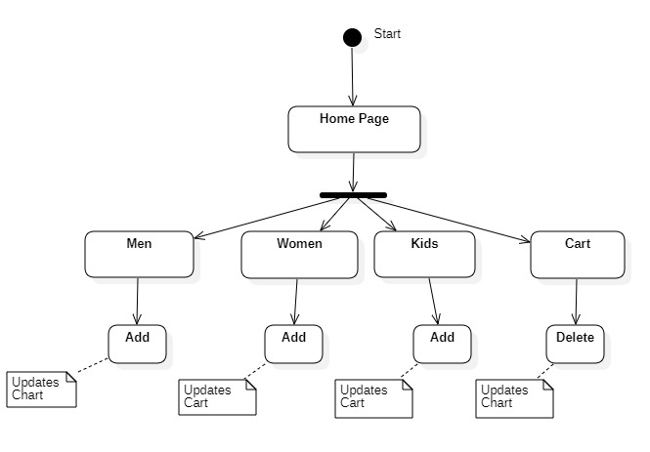
Flowchart

Slide 8
Implementation of React Application
npm install -g create-react-app
npx create-react-app my-react-app
cd my-react-app
npm start
src/App.js
npm run build
Url to access the code: https://github.com/kingkotesh/Final_Year_Project.git

Slide 9

Implementation of JQuery Application
Setup Your Project
Include jQuery( from official website)
Write HTML Structure
Write JavaScript Code
Run Your Application
Url to access the code: https://github.com/kingkotesh/Final_Year_Project.git

Slide 10
Setup Development Environment:
Create Project Structure:
Create JSP Files:
Deploy JSP Files:
Access Your Application:
Optional: Add Java Code:
Test Your Application:
Implementation of JSP Application
URL to access the code: https://github.com/kingkotesh/Final_Year_Project.git

Slide 11
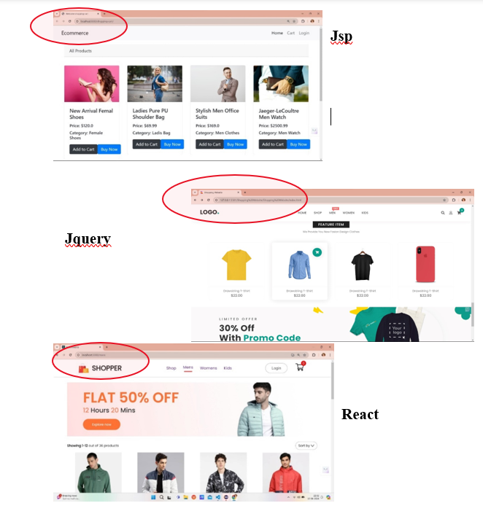
Results
1. Page Reloading
React updates UI efficiently with virtual DOM. Components and state management minimize re-renders. React Router enables smooth client-side navigation.

Slide 12
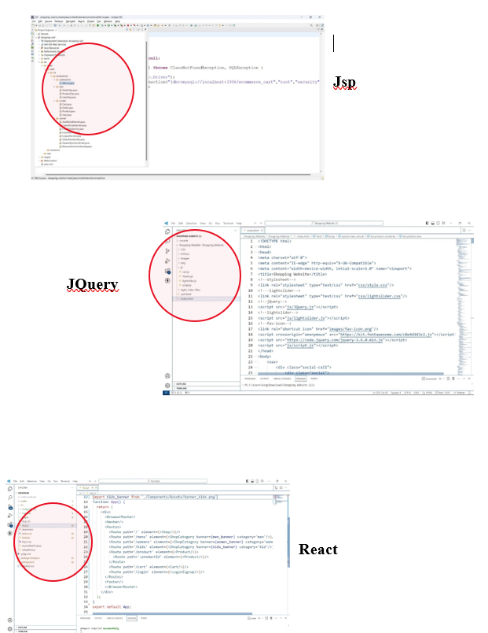
2. Component Based Architecture
Component-based architecture enhances scalability and maintainability by breaking systems into reusable modules. Widely used in frameworks like React and Angular for building UIs.

Slide 13
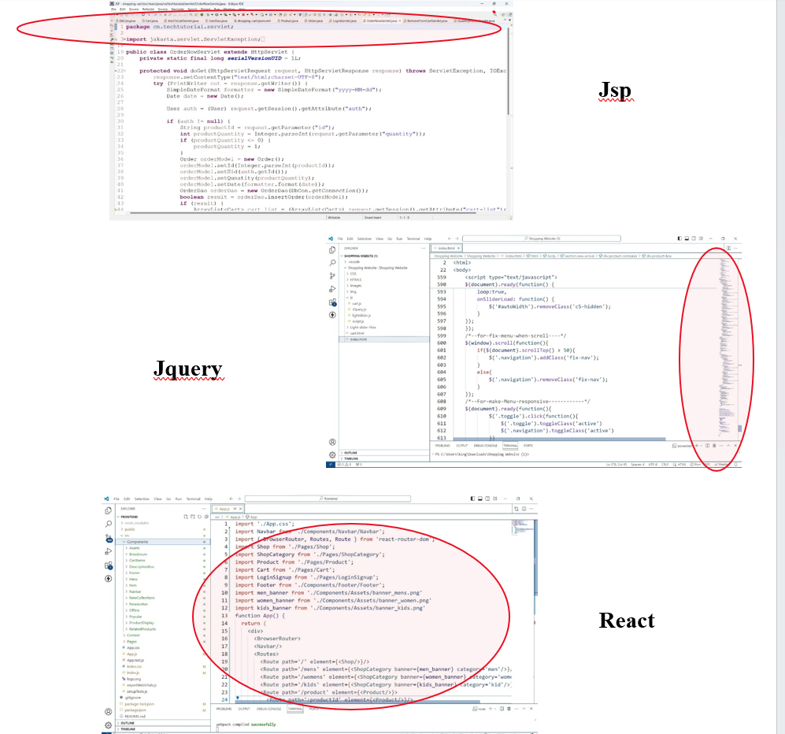
3. Code Reusability And Easy Debugging
React's component-based architecture promotes code reusability and simplifies debugging. Modular components encapsulate state, leading to maintainable codebases. Declarative data flow aids understanding, with tools like React DevTools for efficient debugging.

Slide 14
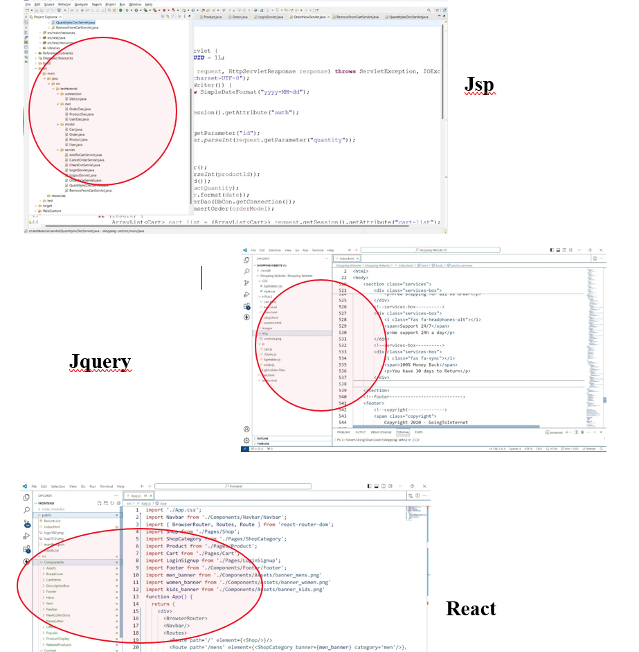
4. Single Page Application
Single-page apps (SPAs) update content dynamically without full-page reloads, enhancing user experience. They load initial resources and fetch data via APIs, commonly built with frameworks like React or Angular.

Slide 15
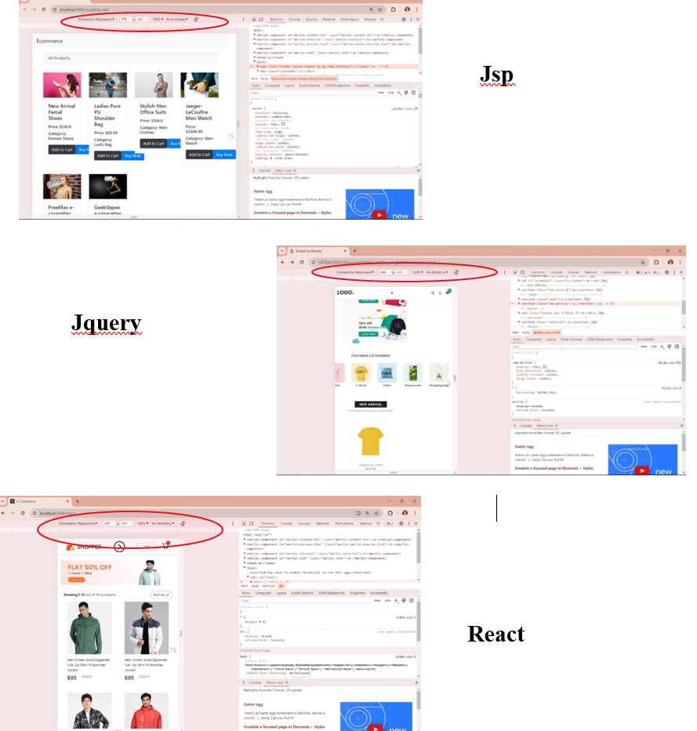
5. Responsive Page
Page responsiveness ensures optimal user experience across devices by adapting layout and content dynamically. Techniques like flexible grids and media queries optimize usability and readability, enhancing accessibility and engagement for higher satisfaction and retention.

Slide 16

React.js has established itself as a powerful and widely adopted JavaScript library for building dynamic user interfaces. Its component-based architecture, efficient rendering with the virtual DOM, and robust ecosystem have contributed to its popularity among developers. Through exploring and assessing React.js, it's evident that it offers numerous advantages, including improved code organization, better state management, enhanced performance, and a vibrant community.
By continuously exploring, evaluating, and enhancing React.js applications, developers can ensure they remain competitive, deliver exceptional user experiences, and stay aligned with industry best practices and emerging trends.
Conclusion

Slide 17

Future Enhancement
ReactJS is very easy to learn, and it is very popular than some other JavaScript frameworks. Many businesses are shifting, or we can say adopting React library because of the simplicity it provides and ease of use. The best advantage of React is Ease of Learning as compared to other popular front-end frameworks like Angular and Vue, we can say that React JS is not going anywhere because according to Stack Overflow, it is the number 1 web framework used by software developers across the world.
Therefore, react is far ahead in competition compared to its rivals like jQuery or Vue. The trend of React JS is not only visible in the US, but even in developing countries like India. A recent report shows the open positions of React JS programmers have increased by 184% post-COVID. Therefore, we can say React will dominate many years in the future on a global scale.

Slide 18

THANK YOU

